Slide 1

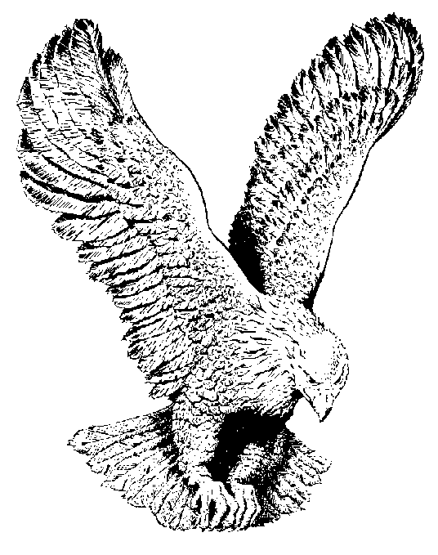
IT’S NOT BY MIGHT
Not by might, nor by power,
But by my Spirit, saith the Lord
Not by might, nor by power,
But by my Spirit, saith the Lord
This mountain shall be removed
This mountain shall be removed
This mountain shall be removed
By my Spirit, saith the Lord.

